Slide 1
Analysis of the relationships between reflective professional practices and the pedagogic well-being of high school teachers
Viorica Dobrica-Tudor & Manon Théorêt
Paris, 2017

Slide 2
Presentation plan
1. Background of the research
2. Conceptual framework
3. Method
4. Presentation and interpretation of the results
5. Discussion et conclusion

Slide 3
1. Background of the research

Slide 4
Working as a teacher: a changing, complex and demanding activity
Difficulties related to the job and professional stress
The students: improper behaviour, lack of motivation and commitment
Characteristics of the school: urban school situated in poor areas, etc.
Characteristics of the job:
workload: unreasonable or unmanageable and results that « do not compensate » the invested efforts
security of employment: instability, mobility between schools, etc.
B. Well-being: based on interactions between professional commitment, stress, exhaustion, self-efficacy, and professional satisfaction

Slide 5
General objective of the research
Exploring the connections between the pedagogic well-being of high school teachers and their reflective professional practices

Slide 6
2. CONCEPTUAL FRAMEWORK

Slide 7
The concept of reflection
Reflection:
a " second degree“ competence that acts like a lever of development of other professional competencies » (Collin, 2010, p.39)
“ a way of thinking about educational matters that involves the ability to make rational choices and to assume responsibility for those choices “ (Ross, 1989, p.22)
Thinking the practice: " the mental process of structuring or restructuring an experience, a problem or an existing knowledge or insights” (Korthagen et Wubbels, 1995).
Reflective practice : a representation that consists of cognitive, affective and volitional dimensions; a representation that brings together social and communicational skills and the process of constructing knowledge (Bruno, Galuppo et Gilardi, 2011)
Notes:
For other et non of
Enlever «to»
Thinking the practice : est-ce que c’est la définition originale? Sinon, il faudrait reformuler la phrase.

Slide 8
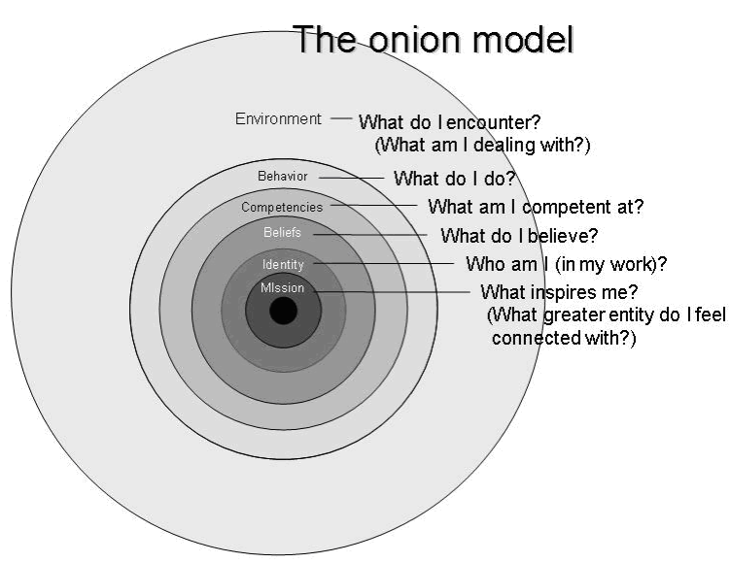
A model for our research: the Korthagen and Vasalos model (2005)

Slide 9
The pedagogic well-being of high school teachers
Soini, Pyhältö et Pietarinen (2010)
Development of the well-being :
a succession of cycles of positive and negative experiences leading to autonomy and commitment;
experiences regularized by professional relationships, sense of belonging to the community, self-efficacy, satisfaction and control.
Dimensions:
Personnel level : competencies, work satisfaction, commitment to work
Social level : interactions with students and colleagues
Impacts : motivation and professional efficacy, mental and physical health among teachers

Slide 10
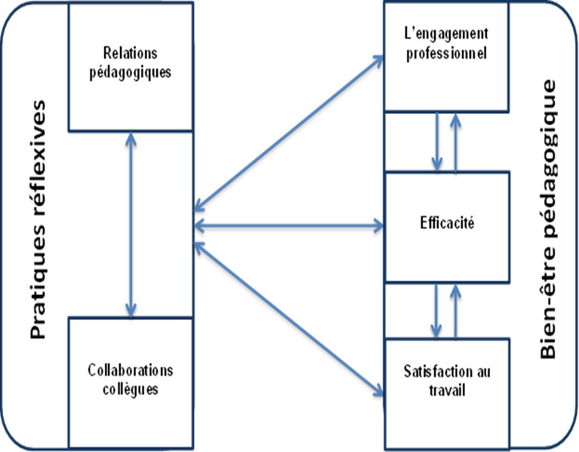
A model of pedagogic well-being to verify: Process established from the commitment and the satisfaction of pedagogical interactions with the students and the collaborations with the colleagues, supported and reinforced by the sense of self-efficacy Theoretical approach : the Bandura sociocognitive theory | Connections between the concepts of professional practices, pedagogic well-being and their associated dimensions:

Slide 11
3. Method

Slide 12
Description of the research
Exploratory and descriptive research
procedures to collect data: face to face conversations of approximately 60 minutes
data collection techniques : the Q methodology and the critical incident technique
Two softwares : QDA Miner et PQMethod
Method of analysis: thematic analysis of content :
discursive examination which allowed the identification of themes, main ideas and key terms for the research (Van der Maren, 1996, p. 414)

Slide 13
Participants:
Synthesis of the professional profiles of the teachers who participated in the study
Variable | Genre |  | Professional experience for high school |  |  | School type |  | Class type
Description of the variable | Woman | Man | 3-5 | 5-10 | 10 + | Public | Private | Regular | Special
Number | 11 | 2 | 1 | 5 | 7 | 10 | 3 | 11 | 2

Slide 14
Answer sheet
-2 (most desagree) | -1 | 0 | +1 | +2 (most agree)
Notes:
Décrire les tâches des enseignants

Slide 15
4. PRESENTATION AND INTERPRETATION OF THE RESULTS

Slide 16
Matrix of contributions of Q-sorts to factors/ The correlation matrix of Q-sorts
 | Teaching contexte | Factor 1 (Behaviours) | Factor 2 (Environment) | Factor 3 (Competencies) | Factor 4 (Identity)
1 | public/teacher | 0.21 | 0.73X | 0.29 | 0.55
2 | public/teacher | 0.24 | 0.83X | 0.67 | 0,67
3 | public/teacher | 0.83 X | 0.61 | 0.36 | 0.44
4 | public/teacher | 0.11 | 0.34 | 0.30 | 0.04
5 | public/teacher | 0.43 | 0,58 | 0.59 | 0.79X
6 | public/teacher | 0.19 | 0.49 | 0.06 | 0.22
7 | public/teacher | 0.40 | 0.81X | 0.13 | 0.35
8 | public/teacher | 0.18 | 0.56 | 0.88X | 0.027
9 | public/remedial teacher | 0. 15 | 0.59 | 0.39 | 0.73X
10 | public/remedial teacher | 0.87X | 0,58 | 0.34 | 0,36
11 | private/teacher | 0.17 | 0.46 | 0.70X | 0,53
12 | private/teacher | 0,80X | 0.26 | 0.17 | 0,26
13 | private/teacher | 0.54 |  | 0.11 | 0.27
Notes:
A correlation matrix was generated with each Q sort correlated with all other sorts; les tris qui expliquent au moins la moitié de la variance d’un facteur et sont
significatifs au seuil de p<.05.

Slide 17
Synthesis sorting of statements by factor
N⁰ | Rank | Statements | Behaviors | Environment | Compe tencies | Iden tity
1 | 8 | In school, I am not interested of the aspects that do not interfere directly with my students’ success. | -1 | -2 | 0 | -2
2 | 13 | I am quite satisfied of my work not to want to change almost anything. | -2 | -1 | 0 | -1
12 | 1 | Starting a new day with my students is far from being a source of satisfaction for me. | -2 | -2 | -2 | -1
3 | 4 | Bringing my students to ask themselves about the content to be learnt is for me a source of satisfaction. | 2 | -1 | 2 | 1
6 | 9 | I avoid sharing my professional experiences with my colleagues. | 0 | 1 | -1 | 1
7 | 5 | During my class, I take time to motivate my students to learn. | 1 | -1 | 2 | 0
4 | 3 | I would say that my students control better than me what happens in class. | -1 | -2 | -2 | -1
9 | 6 | I feel capable to o put into practice efficient strategies to prevent to occurrence of inappropriate behaviours. | 2 | 0 | 1 | 0
10 | 11 | I feel capable to during my conversations with my colleagues. express the relevant reflections | 1 | 1 | 1 | 1
5 | 2 | I consider myself a teacher who is interested by his/her students’ well-being. | 2 | -1 | 1 | 2
11 | 7 | During the reflection activities in group, I feel left out by some of my colleagues. | 0 | -1 | -2 | -2

Slide 18
The pedagogic well-being and the critic incident
 | Form | 1 | 2 | 3 | 4 | 5 | 6 | 7 | 10 | 8 | 9 | 11 | 12 | 13 | Total
Frequency of of the codes: self-efficacy | high | 1 |  | 1 | 4 | 4 |  |  |  |  |  |  |  |  | 52 (4/7)
 | average |  | 1 | 1 | 1 | 2 | 1 | 4 | 2 |  |  | 1
 | low |  | 3 |  |  |  | 1 |  | 1 | 1 | 3 | 3 | 2 | 4
 | Final |  |  |  | 1 | 2 | 2 |  | 1 | 2 |  | 2 | 2
Frequency of of the codes: commitment | high | 4 |  | 3 | 2 | 4 |  | 2 | 2 | 3 |  | 3 |  |  | 35
 | average |  | 2 |  |  |  | 3 | 1 |  |  |  |  | 2 | 4
Frequency of of the codes: satisfaction | collectively high |  |  | 2 |  | 1 |  |  |  |  |  |  |  |  | 27 (2/2/7)
 | student high |  |  |  |  | 2 |  |  | 1
 | student average |  |  |  | 2 |  |  |  |  | 1
 | student low |  | 5 |  |  |  |  |  |  |  |  |  |  | 4
 | generally average |  |  |  |  | 1
 | Progressive |  |  |  | 1 | 1 | 1 | 1 |  | 1 |  | 1 | 2

Slide 19
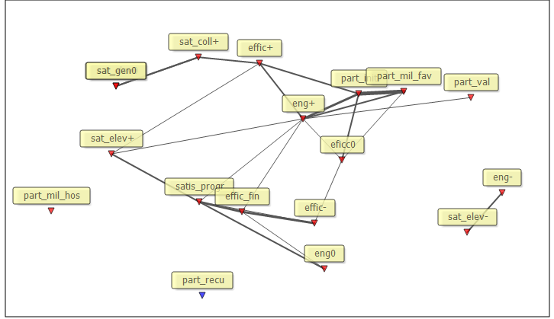
Collaboration with the colleagues and the teachers’ well-being

Slide 20
5. DISCUSSION AND CONCLUSION

Slide 21
Objective 1. Identifying the teachers’ perception on the three dimensions of the well-being
It seems that high-school teachers perceive the three dimensions of the pedagogic well-being presented in the analysis in a relation of interdependence
the dimension most mentioned: self-efficacy, which agrees with the theoretic approach of the research
the collective efficacy believes seem to be most influenced by the nature of the professional experiences with the students

Slide 22
Limits of the study
Non-probability sample of only 13 teachers, which limits the generalization of the conclusions ; results with a hypothetic character
Use of auto-reported methods : the quality of our results is influenced by the honesty of the participants, and these only reflect the perception of the participants
The arrangement of the statements can be a difficult and demanding task, which risks to generate a certain frustration to the participants
The technique of the critical incidents: its content « is based on the expression and the representation of personal experience » (Felio et Carayol, 2013).

Slide 23
Benefits and effects of the study
From a theoretical point of view:
empirical evidence that there is a connection between the teachers’ thinking about the professional practices and their pedagogic well-being
From a methodological point of view:
the Q methodology : a pertinent tool for studies that try to highlight the subjectivity and the general tendencies about the teachers’ thinking upon their practices
the critical incident technique, by references to events associated to strong emotions, can be used as a tool to explore the well-being
Pedagogically:
The importance of the thinking on multiple levels :

Slide 24
Towards future studies
Professional environment
Satisfaction at work
Self-efficacy
Commitment
Commitment
Professional behaviours et competencies
Teachers’ essential qualities

Slide 25
References
1. Bandura, A. (1997). Self-efficacy. The exercise of Personal Control. New York : Freeman.
2. Bruno, A., Galuppo, L., & Gilardi, S. (2011). Evaluating the reflexive practices in a learning experience. European Journal of Psychology of Education, 26(4), 27-543.
3. Collin, S. (2010a). L'interaction en ligne comme soutien à la pratique réflexive des enseignants-stagiaires. Université de Montréal, Montréal. Retrieved from www.papyrus.bib.umontreal.ca
4. Korthagen, F. A. J., & Wubbels, T. (1995). Characteristics of reflective practitioners: Towards an operationalization of the concept of reflection. Teachers and Teaching: Theory and Practice, 1(1), 51-72.
5. Korthagen, F. A. J. (2009). Professional Learning from within. Studying Teacher Education, 5(2), 195-199.
6. Korthagen, F. A. J., & Vasalos, A. (2005). Levels in reflection: Core reflection as a means to enhance professionnal growth. Teachers and Teaching: Theory and Practice, 11(1), 47-71.
7. Ross, D. (1989). First steps in developing a reflective approach. Journal of Teacher Education, 40(2), 22-30.
8. Soini, T., Pyhältö, K., & Pietarinen, J. (2010). Pedagogical well-being: reflecting learning and well-being in teachers’ work. Teachers and Teaching: Theory and Practice, 16(6), 735-751.
9. Van der Maren, J.-M. (1996). Méthodes de recherche pour l’éducation. Paris, Bruxelles: De Boeck et Larcier s.a.

